Slide 1


EESSI test suite
10th EasyBuild User Meeting@ Juelich
Thu 27 March 2025
Caspar van Leeuwen (SURF)
Lara Peeters (Ugent)
Sam Moors (VUB)

Slide 2

The EESSI test suite
Goal of the EESSI test suite
To test the functionality and performance of the EESSI software stack on a wide range of systems
The opportunity
Same software (modules) on every system
The challenge
Every system is different! Need tests that are portable
2

Slide 3
Writing portable tests is challenging…
EESSI test suite is based on ReFrame
ReFrame tests are typically very system specific, example attributes:
valid_systems: on which systems this test can/should run
num_cpus_per_task, num_tasks, num_gpus_per_node: typically chosen to match the system
And many more …
ReFrame offers amazing fine-grained control, but at the cost of portability
3

Slide 4
How we make EESSI tests portable
All system-specific information goes into ReFrame config file
Make the test do something sensible based on the config file, examples:
Launch one rank per available (physical) CPU core / numa node / socket / GPU
Skip a test if the system has insufficient memory to run it
Skip a test that requires GPUs if the system doesn’t have any
N.B. Tests ≠ benchmarks! These portable tests are not guaranteed to get the best performance from your system for a particular use case, they are meant to spot performance changes.
4

Slide 5
MPI4PY example
@rfm.simple_test
class EESSI_MPI4PY(rfm.RunOnlyRegressionTest, EESSI_Mixin):
device_type = DEVICE_TYPES[CPU]
compute_unit = COMPUTE_UNIT[CPU]
module_name = parameter(find_modules('mpi4py'))
n_iterations = variable(int, value=1000)
n_warmup = variable(int, value=100)
executable = 'python3'
executable_opts = ['mpi4py_reduce.py', '--n_iter', f'{n_iterations}', '--n_warmup', f'{n_warmup}']
time_limit = '5m00s'
bench_name = 'mpi4pi'
bench_name_ci = 'mpi4pi'
readonly_files = ['mpi4py_reduce.py']
def required_mem_per_node(self):
return self.num_tasks_per_node * 100 + 250
@sanity_function
…
@performance_function('s')
…
Requires ‘CPU’ feature
Launch one task per core
Create tests for all modules called mpi4py/<something>
Automatically tags a test instance with this bench_name with ‘CI’ tag
Request sufficient memory, and skip if nodes don’t have enough
5
See https://www.eessi.io/docs/test-suite/writing-portable-tests/#as-portable-reframe-test

Slide 6
How we use the EESSI test suite
We run the test suite periodically (daily/weekly) on about 5 different systems
We run selected (single node) tests when building new software for EESSI (before deployment)
Some of us also use the test suite to test local module stacks!
6

Slide 7
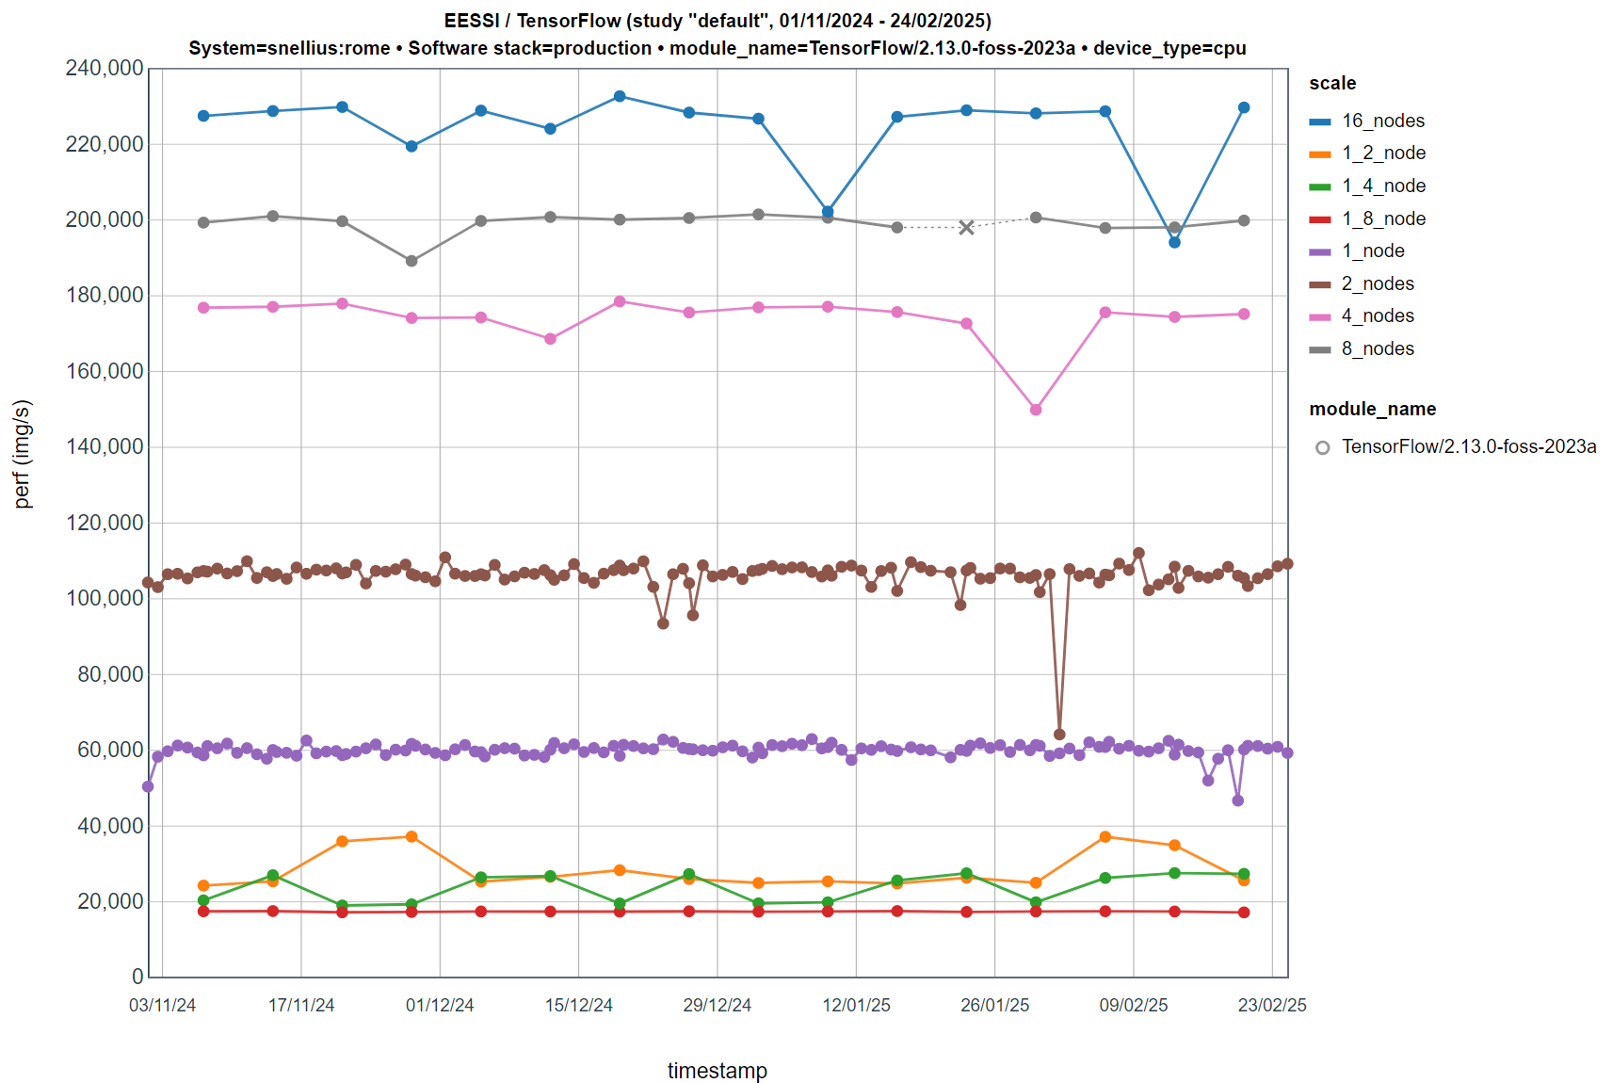
7

Slide 8
Writing an EESSI test suite configuration
Goal: For everyone to have run the EESSI test suite on your HPC cluster (or laptop) by the end of EUM’25!
Step 1: install ReFrame & the EESSI test suite
Step 2: create a ReFrame configuration file
Step 3: run reframe --list -t CI
Step 4: run reframe --dryrun -t CI -n /<somehash>
Step 5: run reframe --run -t CI -n /<somehash>
8

Slide 9
Find presentation online
Detailed steps on subsequent slides
Quickest way: copy-paste from slides at https://github.com/casparvl/EUM25
9

Slide 10
Step 1: Install ReFrame & EESSI test suite
module purge # Use system python
python3 -m venv $HOME/eessi_testsuite/eessi_testsuite_venv
source $HOME/eessi_testsuite/eessi_testsuite_venv/bin/activate
pip install reframe-hpc
pip install eessi-testsuite
# Check we can use things from ReFrame’s hpctestlib
python3 -c 'import hpctestlib.sciapps.gromacs'
# Check we can use things from the EESSI testsuite
python3 -c 'import eessi.testsuite.eessi_mixin'
See: https://www.eessi.io/docs/test-suite/installation-configuration/
10

Slide 11
Step 2a: create ReFrame config file
cd $HOME/eessi_testsuite/
wget https://raw.githubusercontent.com/casparvl/test-suite/refs/heads/update_example_settings/config/settings_example.py export RFM_CONFIG_FILES=$HOME/eessi_testsuite/settings_example.py
export RFM_PREFIX=$HOME/eessi_testsuite/reframe_runs
export RFM_CHECK_SEARCH_PATH=$HOME/eessi_testsuite/eessi_testsuite_venv/lib/python3.9/site-packages/eessi/testsuite/tests/
export RFM_CHECK_SEARCH_RECURSIVE=1
11

Slide 12
Step 2b: create ReFrame config file
Now, modify settings_example.py to match your system
Define a stagedir on a shared filesystem
Select the matching scheduler https://reframe-hpc.readthedocs.io/en/stable/config_reference.html#config.systems.partitions.scheduler (set local if you are doing this on your laptop)
Select the matching parallel launcher https://reframe-hpc.readthedocs.io/en/stable/config_reference.html#config.systems.partitions.launcher (mpirun should work for everyone, but you can use e.g. srun )
Modify the access field to define arguments to be passed to the scheduler, etc. It should define a homogeneous set of nodes
12

Slide 13
Step 2c: create ReFrame config file
Now, modify settings_example.py to match your system
Under resources set the flag that should be passed to your scheduler to define required memory per node and pass {size} as argument
Slurm users: ‘--mem={size}’
Local spawner: ‘--whatever={size}’ (unused)
Define the max available memory per node under the EXTRAS.MEM_PER_NODE item (in MiB).
SLURM users: check scontrol show node <nodename> for the RealMemory on your nodes.
Local spawner: put anything (unused)
13

Slide 14
Step 2d: create ReFrame config file
Now, modify settings_example.py to match your system
Under features specify what FEATURES (CPU/GPU) and SCALES your system support
CPU partition: ‘features’: [FEATURES.CPU],
GPU partition where you don’t want to run CPU-only tests: ‘features’: [FEATURES.GPU],
GPU partition where you also want to run CPU-only tests: ‘features’: [FEATURES.CPU, FEATURES.GPU],
To run all scales (up to 16 nodes): ‘features’: [FEATURES.XYZ] + list(SCALES.keys())
To run only single (full) node (e.g. local laptop): ‘features’: [FEATURES.XYZ] + [key for key, value in SCALES.items() if value.get("num_nodes") == 1]
GPU partitions only: under extras define EXTRAS.GPU_VENDOR: GPU_VENDORS.NVIDIA
14

Slide 15
Step 3: run reframe --list -t CI
Run reframe --list -t CI
You may get things like “WARNING: skipping test 'EESSI_TensorFlow': the following parameters are undefined: module_name”. That’s ok, it simply means you don’t have the software(module) needed to run this test
15

Slide 16
Step 3: run reframe --list -t CI
Run reframe --list -t CI
If you get “WARNING: failed to retrieve remote processor info: command 'sbatch rfm-detect-job.sh' failed with exit code 1:”, ReFrame’s automatic CPU detection failed.
Check the ReFrame log (“Log file(s) saved in ‘/path/to/log’”)
You might be missing access arguments
If it keeps failing, you could try ‘manually’ running reframe --detect-host-topology on the relevant node https://www.eessi.io/docs/test-suite/ReFrame-configuration-file/#create-topology-file . Then copy to ~/.reframe/topology/<system>-<partition>/processor.json
16

Slide 17
Step 3: run reframe --list -t CI
Run reframe --list -t CI
You’ll need to have at least one module available for which we have a test ☺
If you don’t, simply install e.g. a CPU version of OSU-MicroBenchmarks with EasyBuild
Expected output:
…
- EESSI_TensorFlow %scale=2_nodes %module_name=TensorFlow/2.13.0-foss-2023a %device_type=cpu /cbc475c5
- EESSI_TensorFlow %scale=1_node %module_name=TensorFlow/2.13.0-foss-2023a %device_type=cpu /9864d0f5
Test hash
17

Slide 18
Step 4: run reframe --dryrun -t CI
Run reframe --dryrun -t CI –n /<testhash> to just run an individual test as an example
Check the jobscript ReFrame will generate & submit in <stagedir>/<system_name>/<partition_name>/default/<testname_testhash>/rfm_job.sh
If you have issues, that job script is (probably) your first place to look!
18

Slide 19
Step 5: run reframe --run -t CI
Run reframe --run -t CI –n /<testhash> to just run an individual test as an example
19

Slide 20
Summary
Writing the ReFrame config requires some knowledge specific to the EESSI test suite, but is documented https://www.eessi.io/docs/test-suite/ReFrame-configuration-file/
Apart from the ReFrame config, the EESSI test suite is ‘plug-and-play’!
Number of supported applications is could be bigger – open to new contributions (see https://www.eessi.io/docs/test-suite/writing-portable-tests/ )
EESSI test suite is application-focused: no replacement for system-specific (e.g. scheduler or filesystem) tests
Credit to ReFrame devs: EESSI test suite is possible because they spent time on our bug reports & feature requests ☺
20

